Slide 1
Intellectual Property
Licensing and elements of a license

Slide 2
License defined
The grant of a limited right in the use of a
  Product
  Design
  Process
  Trademark or service mark
  Right under copyright
  Name, likeness, portrait or other aspect of one’s persona
Ownership and control remains with the licensor

Slide 3
Terminology of a License Grant
Typical grant:
  Subject to the terms and conditions of this Agreement as well as payment of all applicable license fees for the term of such license, Licensor hereby grants to Licensee and Licensee hereby accepts a non-transferable, perpetual, limited, personal, non-exclusive license to use the Software solely for Licensee's internal business purposes in the United States for the specified number of users as described in the attached Exhibit A.
Each term has specific meaning that fundamentally impacts the rights of the licensor and licensee.

Slide 4
Terminology of a License Grant (cont.)
Licensee
  The broader the definition, the more entities or individuals who will have access.
  Affiliates – how defined?
Licensor - Licensee wants to ensure that Licensor owns IP or has the right to grant a license.
Perpetual – usually provided in recognition of rapid obsolescence of software in general.
Personal, internal business purpose – prevents outsourcing and use in data centers. Use only for specific business purpose.
Nonexclusive or exclusive

Slide 5
Restrictions
Reverse Engineering
  Most proprietary licenses prevent reverse engineering, decompiling or recompiling code.
  Licensor does not want object code converted into source.
Other limitations
  Limiting use of software to a particular CPU, a class of computers or a geographic site.

Slide 6
Significant Clauses
Representations and Warranties
  Not mutually exclusive and have different consequences.
  Do not make representations but always try to get them.
Licensor Warranties
  Warranty of Title
  System Warranty
  Performance Standards
  Services delivered in a professional and workmanlike manner.
  Accurate documentation
  Free from defects in media
  Intellectual Property

Slide 7
Significant Clauses (cont.)
Warranty Disclaimer
  Implied Warranties
  Applicability of UCC
Specific Disclaimers
  Misuse of Software
  Modification of Software
Indemnification
  Negligence
  Intellectual Property
Limitation of Liability
Termination
Governing Law and Venue

Slide 8
Common mistakes
Attempting to make the wrong template "fit" for this license
  Find out the basic facts about the license before drafting
    With ongoing negotiations, this may not be possible, however, find out what is fixed and what is still being negotiated
Not reading the whole license
  Read the whole license, both early and at the end of the negotiations. Don’t skip parts
Not involving the appropriate parties
  technical folks
  decision makers
  lawyers

Slide 9
Common mistakes (continued)
Not providing attachments
  If attachments already exist, get copies early in the process
Effective date vs. execution date
  Don't confuse the two
No termination

Slide 10
Intellectual Property
Open source software licensing

Slide 11
Software
Object code
  Executable code used by the computer
  Very difficult for humans to read and understand
Source code
  ‘High level’ code written by programmers
  Necessary for making changes and improvements
  Converted to object code by a compiler

Slide 12

Source and object code
High Level Language
Compiler
Object Code
(define
(percent num denom)
;;converts to percent
(* (/ num denom) 100))
101100 0001001
101101 1111001
101110 1001000
101111 1011001
(define X090 X091 X092)
(* (/ X091 X092) 100))
Reverse
Compiler

Slide 13
OSS licensing
Open Source Software overview
What is Open Source Software or OSS?
  Open Source Software is software where the source code is available for use, modification and redistribution.
    It is copyright protected and governed by a license agreement.
    It is not proprietary software.
    It is not in the public domain.
    It is not freeware or shareware.
    It is not free of legal restrictions and it is not free of any risk or liability.
    <Open Source Initiative>
Why do we care?
  Open Source licensing schemes are based upon principles of copyright law, giving the author of a work the right to determine the terms on which her work may be copied, modified and distributed. Failure to abide by an open source license is a violation of the law.
Why does E&IS have a (new) policy about it?
  To control the use of open source and minimize the risk associated with use.

Slide 14
OSS licensing
Types of Open Source Software licenses
Some licenses apply no restrictions on the distribution of derivative works
  Licensor retains copyright and grants all rights under the copyright to the licensee
  Examples include the Academic Free License, Apache Software License, BSD License, MIT License, Sleepycat License
Others apply restrictions to ensure that the source code delivered under the license will always be open/free.
  Licensor retains copyright and grants all rights under copyright with one restriction – that redistribution of software, whether modified or unmodified, must be under the same license.
  Examples include GNU General Public License, Mozilla Public License, Artistic License.

Slide 15
OSS licensing
OSS licenses span the range of restrictiveness
The most restrictive license is the GNU General Public License (GPL)
  Any derivative work that incorporates a GPL product must itself be licensed as a GPL product, with source code available
GNU Lesser General Public License (LGPL) is a less restrictive variant of the GPL
  Designed for products whose creators wish them to become ubiquitous
The least restrictive license is the Berkley license
  One is able to use the open source code for whatever purpose they desire, including creating a commercial product
Many other licenses are listed on the OSI website
  http://www.opensource.org/

Slide 16
Scenario
An engineer pulled a piece of open source code from the web and integrated it into a deliverable for a government customer
The open source license requires that derivative works be distributed as open source
Next step is to sell this to a foreign government
The export license from the State Department prohibits the distribution of source code
What do you do?

Slide 17
OSS licensing
Bottom line on Open Source licensing
Check the license
  Make sure it is suitable for your use
  GPL governed software is not suitable for use in proprietary software
Make sure you comply with the FAR, DFAR and the copyright laws
  Legal and Contracts organizations can help here
Ask yourself:
  Is software coming in for evaluation?
  For internal development and testing?
  Will it be modified?
  How will it be linked (statically or dynamically) or otherwise combined with other company and third party software?
  Are downstream rights needed?
  Who has contributed to the code thus far?

Slide 18
OSS licensing
Risks in using Open Source Software
Tainting of proprietary code
  Proprietary code that incorporates open source subject to the GPL may result in loss of ability to exploit proprietary code
  Choice is to violate license, and consequently copyright law, or lose ability to license proprietary code
Intellectual Property (IP) infringement
  No warranties or indemnity for IP infringement
  Possibility that programmer added infringing code to open source software
  Companies like JBoss, Red Hat, Novell and others offer indemnification as part of their services

Slide 19
OSS licensing
Open Source Software and the DoD
Must ensure that the OSS complies with the same DoD policies that govern COTS and GOTS software
Must comply with all lawful licensing requirements
“As licensing provisions may be complex, the DoD components are strongly encouraged to consult legal counsel to ensure that the legal implications of the license are fully understood.”

Slide 20
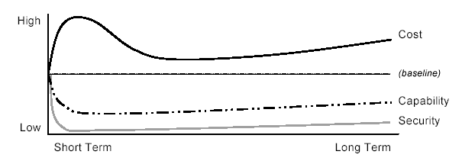
OSS overview
Likely impacts of OSS ban at DoD
Source – Use of Free and Open-Source Software (FOSS) in the U.S. Department of Defense Copyright 2002 by The MITRE Corporation. All rights reserved.

Slide 21
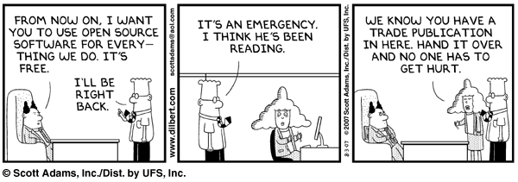
OSS overview
OSS makes the comics

